Slide 1

Deck OF Cards API
https://deckofcardsapi.com/
By: martin Kucharek

Slide 2
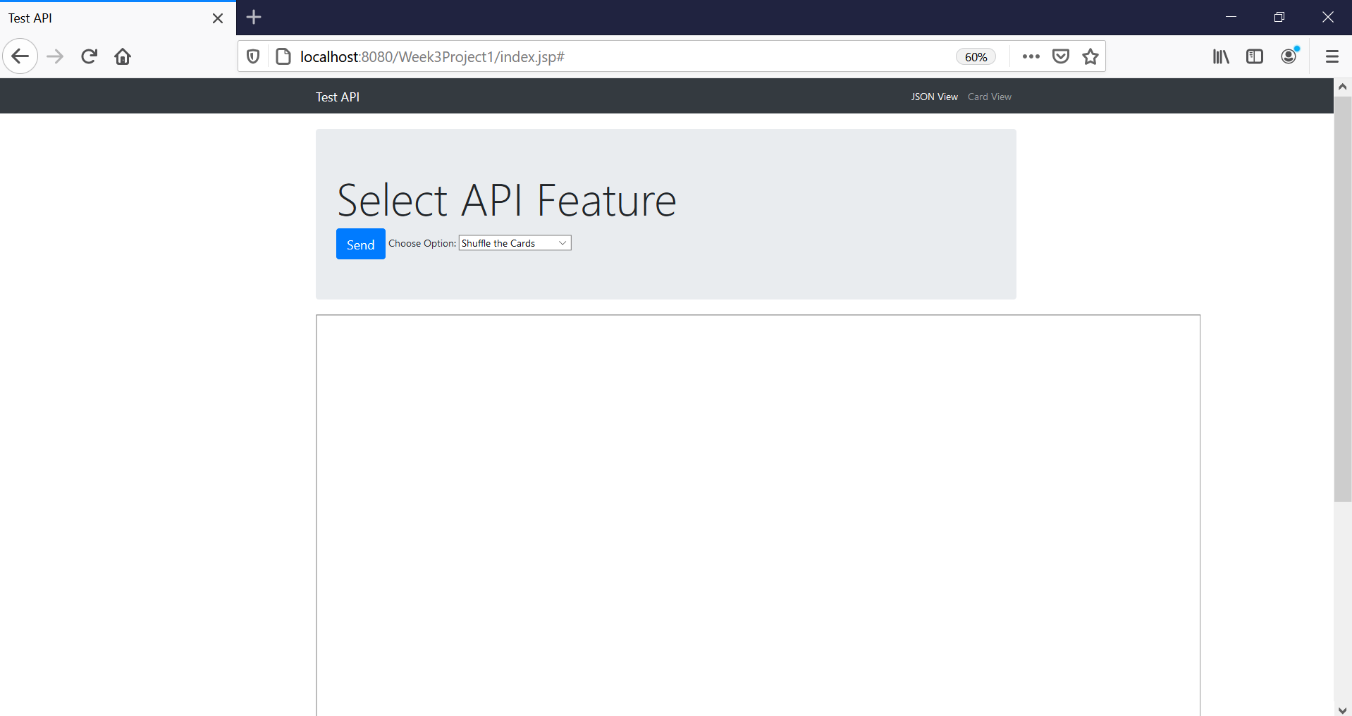
Website

Slide 3
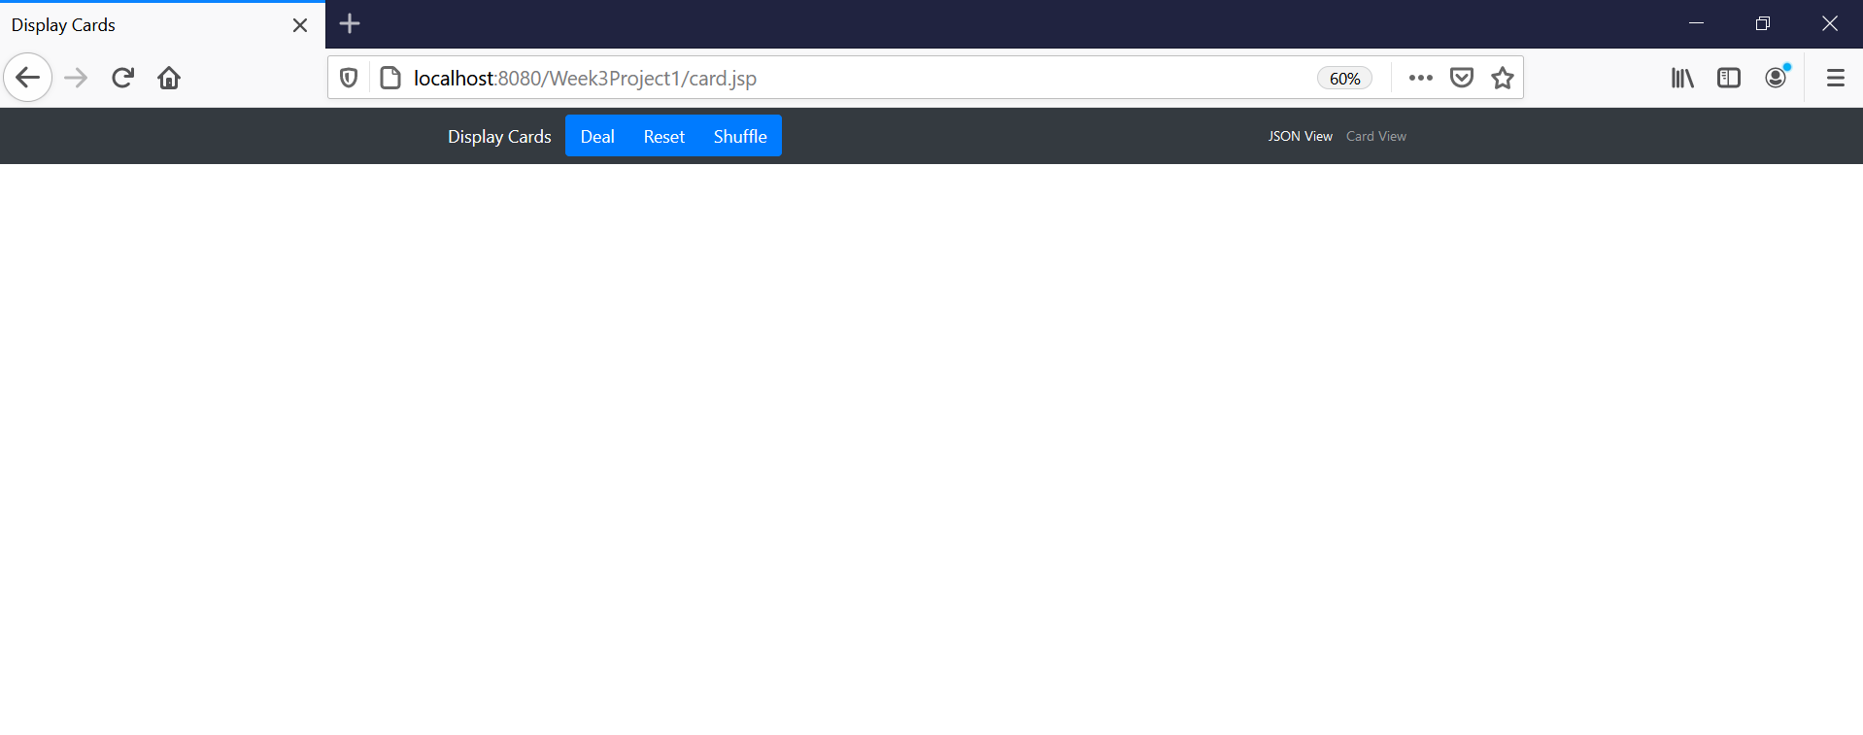
Website

Slide 4
Project Plan
Get API to work
Pick 3 methods to display cards

Slide 5
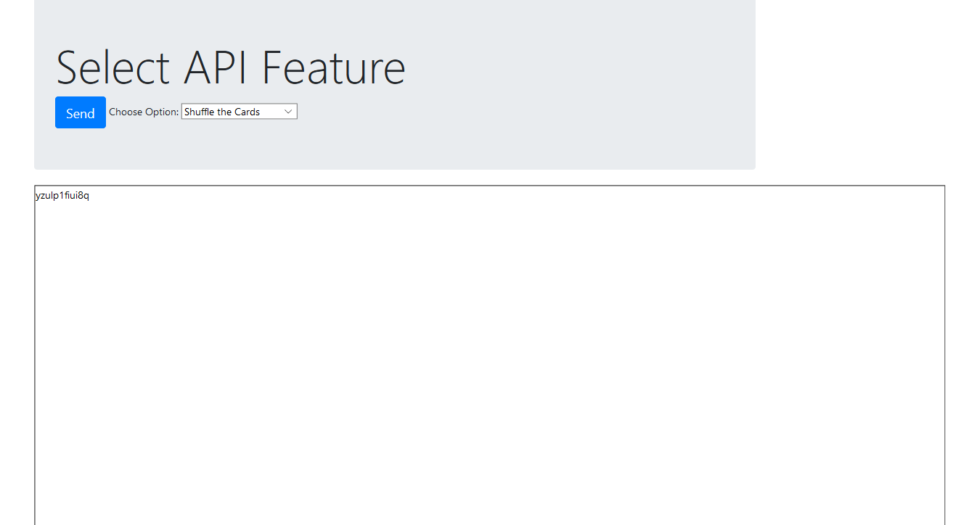
GET API TO WORK

Slide 6
Used API Method 1
A Brand New Deck
https://deckofcardsapi.com/api/deck/new/
{
"success": true,
"deck_id": "3p40paa87x90",
"shuffled": true,
"remaining": 52
}

Slide 7
Used API Method 2
{
"success": true,
"cards": [
{
"image": "https://deckofcardsapi.com/static/img/KH.png",
"value": "KING",
"suit": "HEARTS",
"code": "KH"
},
{
"image": "https://deckofcardsapi.com/static/img/8C.png",
"value": "8",
"suit": "CLUBS",
"code": "8C"
}
],
"deck_id":"3p40paa87x90",
"remaining": 50
}
Draw a Card
https://deckofcardsapi.com/api/deck/<<deck_id>>/draw/?count=2

Slide 8
Used API Method 3
Reshuffle the Cards
https://deckofcardsapi.com/api/deck/<<deck_id>>/shuffle/
{
"success": true,
"deck_id": "3p40paa87x90",
"shuffled": true,
"remaining": 52
}

Slide 9
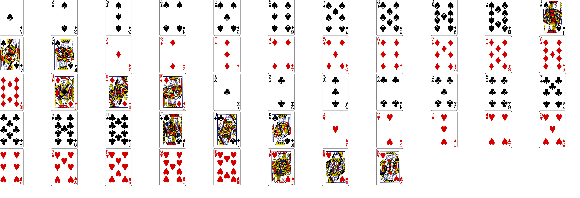
Deal Cards

Slide 10
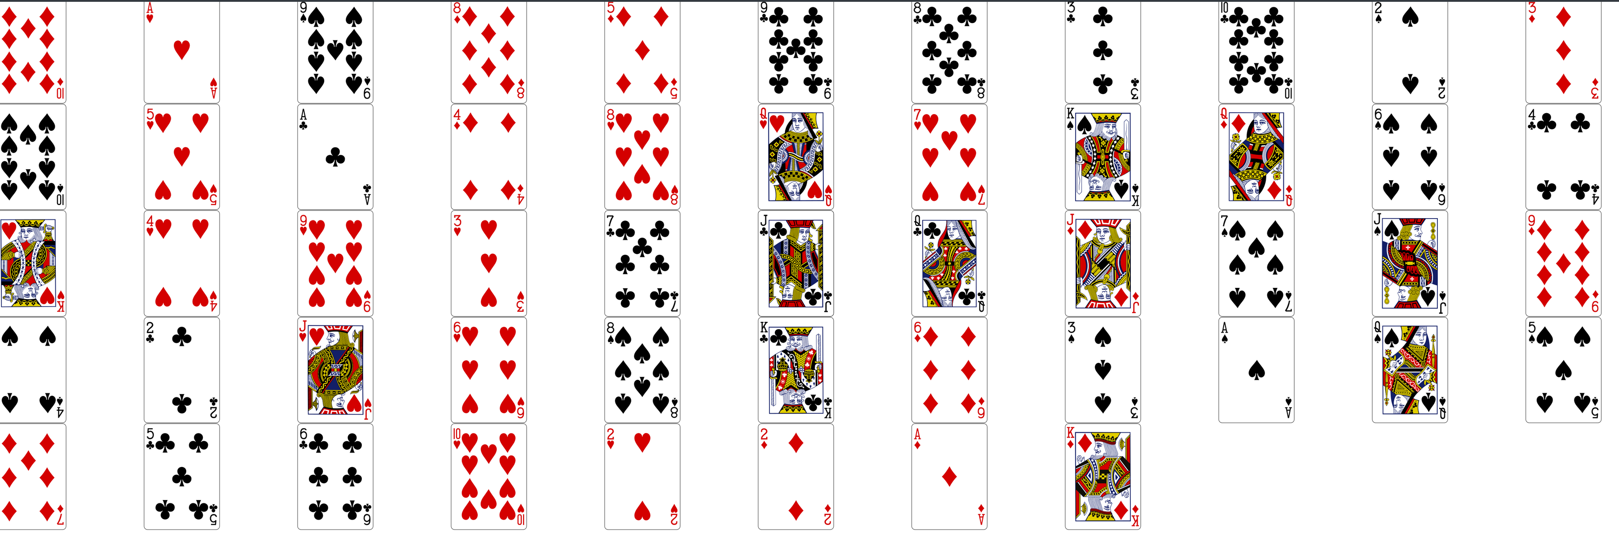
Shuffle and Deal Cards

Slide 11
Link
https://github.com/martin989/SENG315-Week3Project1.git

